Slide 1
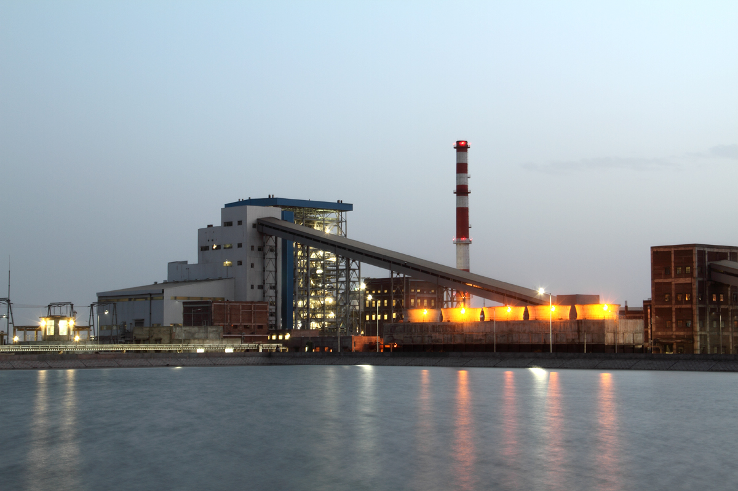
www.powerplantinstrumentation.yolasite.com

Slide 2
In India 65% of total power is generated by the Thermal Power Stations .
Main parts of the plant are
1. CHP 2.Boiler 3. Coal ash 4.APH 5. DMP 6. ESP 7. Chimney 8. Turbine 9. Condenser 10. Transformers 11. Cooling towers 12. Generator 13.Sub Station 14.BFP 15. ACW 16. AVR 17.TSP 18.LPH 19.HPH 20.Deareator.

Slide 3
BASIC OPERATION :
A thermal power plant basically works on Rankine cycle.
COAL CONVEYOR :
This is a belt type of arrangement. With this coal is transported from coal storage place in power plant to the place near by boiler.

Slide 4
STOKER :
The coal which is brought near by boiler has to put in boiler furnance for combustion. This stoker is a mechanical device for feeding coal to a furnace.
PULVERIZER :
The coal is put in the boiler after pulverization.For this pulverizer is used. A pulverizer is a device for grinding coal for combustion in a furnace in a power plant .An impact mill is used for this purpose.

Slide 5
BOILER: pulverized coal is put in boiler furnace in which water is heated and circulated until the water is turned in to steam at the required pressure. Coal is burned inside the combustion chamber of boiler. These gases which are at high temperature vaporize the water inside the boiler to steam

Slide 6
SUPERHEATER :
Superheater is a component of a steam-generating unit in which steam, after it has left the boiler drum, is heated above its saturation temperature. The amount of superheat added to the steam is influenced by the location, arrangement, and amount of superheater surface installed, as well as the rating of the boiler Superheaters are classified as convection , radiant or combination of these

Slide 7
REHEATER :
Reheater is also steam boiler component in which heat is added to this intermediate-pressure steam, which has given up some of its energy in expansion through the high-pressure turbine. The steam after reheating is used to rotate the second steam turbine where the heat is converted to mechanical energy.

Slide 8
CONDENSER :
Steam after rotating steam turbine comes to condenser. Condenser refers here to the shell and tube heat exchanger installed at the outlet of every steam turbine in Thermal power stations. These condensers are heat exchangers which convert steam from its gaseous to its liquid state. In so doing, the latent heat of steam is given out inside the condenser .

Slide 9
COOLING TOWERS :
The condensate water after condensation is initially at high temperature. This hot water is passed to cooling towers. It is a tower in which atmospheric air circulates in direct or indirect contact with warmer water and the water is thereby cooled. Water, acting as the heat-transfer fluid, gives up heat to atmospheric air, and thus cooled, is recirculated through the system.

Slide 10
ECONOMISER :
Flue gases coming out of the boiler carry lot of heat. Function of economiser is to recover some of the heat from the heat carried away in the flue gases up the chimney and utilize for heating the feed water to the boiler. It is placed in the passage of flue gases in between the exit from the boiler and the entry to the chimney.

Slide 11
AIR PREHEATER :
The remaining heat of flue gases is utilised by air preheater. It is a device used in steam boilers to transfer heat from the flue gases to the combustion air before the air enters the furnace

Slide 12
ELECTROSTATIC PRECIPITATOR :
It is a device which removes dust or other finely divided particles from flue gases by charging the particles inductively with an electric field, then attracting them to highly charged collector plates.

Slide 13
SMOKE STACK (CHIMNEY) :
A chimney is a system for venting hot flue gases or smoke from a boiler, stove, furnace or fireplace to the outside atmosphere. They are typically almost vertical to ensure that the hot gases flow smoothly, drawing air into the combustion through the chimney effect

Slide 14
GENERATOR :
An alternator is an electromechanical device that converts mechanical energy to alternating current electrical energy. Most alternators use a rotating magnetic field. Any AC generator can be called an alternator, but usually the word refers to small rotating machines driven by automotive and other internal combustion engines.

Slide 15
TRANSFORMERS :
It is a device that transfers electric energy from one alternating-current circuit to one or more other circuits, either increasing (stepping up) or reducing (stepping down) the voltage

Slide 16
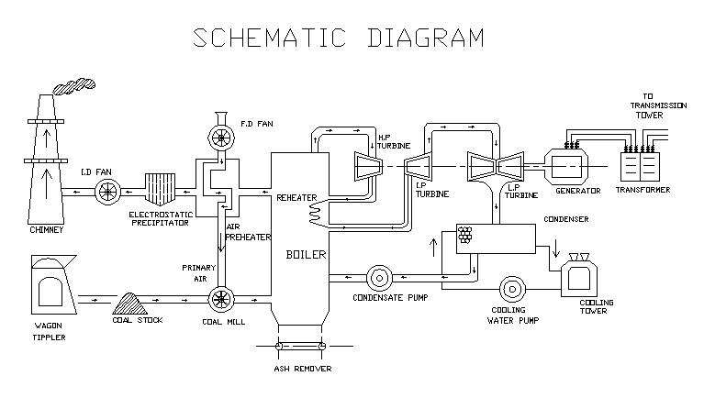
Plant layout

Slide 17
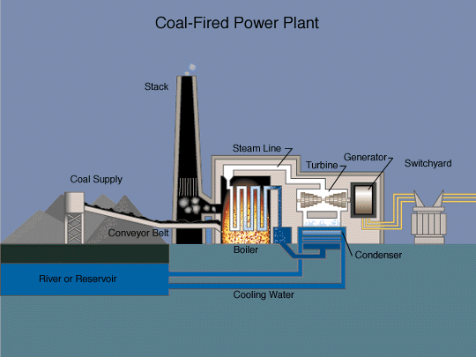

Slide 18


