Slide 1
Waste Water Recycling System-Effluent System
D.Chakraborty

Slide 2
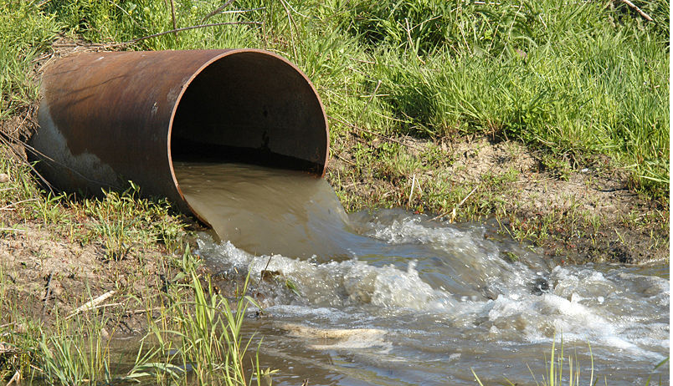
What is Effluent system
Effluent is defined by the United States Environmental Protection Agency as “wastewater - treated or untreated - that flows out of a treatment plant, sewer, or industrial outfall. Generally refers to wastes discharged into surface waters”.

Slide 3
Strategies
In the context of a thermal power station, the output of the scraper chain system may be referred to as the effluent water, which is noticeably warmer than the environment. Effluent only refers to liquid discharge.
In crescent power limited this effluent water is re-cycled and send back to the originating source and the slurry water from collecting sump pit sent to HCSD system.

Slide 4
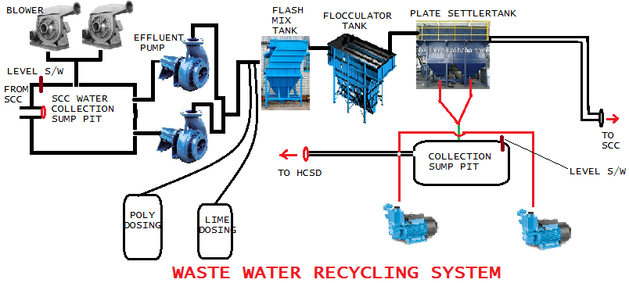
Over View of WWRS

Slide 5
Specifications
SCC Water Flow inlet– 30m3/Hr
PH- 6 to 9
TSS – 1140mg/l
ETP Flow – 15m3/hr
Sludge Transfer Pump Flow – 5m3/hr
Air Blower – 30m3/hr , 0.3kg/cm2
Lime Dosing – 50lit/Hr
Poly Dosing – 30 lit/Hr
Recycle SCC Water Flow – 28m3/Hr
PH- 6 TO 9
TSS- <60mg/l

Slide 6
Operational Process
The waste water coming from boiler-1 & boiler 2 , scrapper chain conveyor at a flow rate of 30m3/Hr get collected at sump pit. Air blower are providing air to the waste water deposited at sump pit from bottom fitted nozzle to avoid sedimentation of ash at the bottom of pit.
The effluent transfer pump transfer this waste water to flash mixture tank after lime and poly dosing.
These dosing are done to maintain the PH of the water at continuous basis.
Then it is transferred to frocculator tank for better stirring of treated water and final sedimentation of ash is done in plate settler tank , where 90-95% of ash removed and send to sludge sump pit and the treated fresh water is again recycled to scrapper chain conveyor.
The two number of sludge pump transfer the sludge to HCSD Plant.

Slide 7
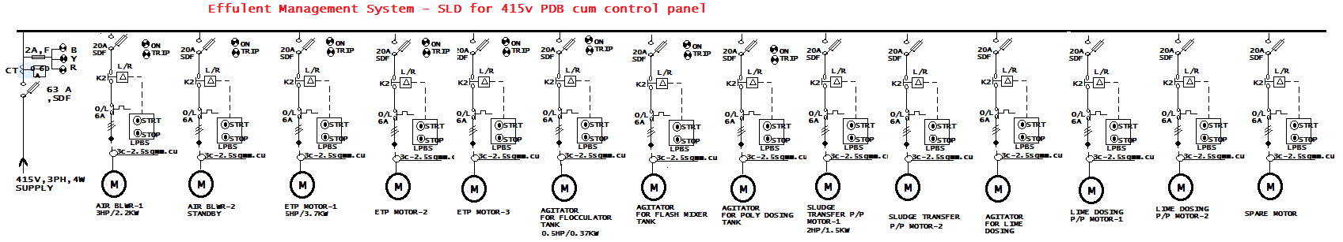
SLD FOR 415V PDB OF WWRS

Slide 8
Chemical Dosing Criteria
Alum Dosing – 10% used for cleaning of water.
Poly Dosing – 0.10 – 0.15% used for sedimentation of ash also termed as coagulation -flocculation

Slide 9
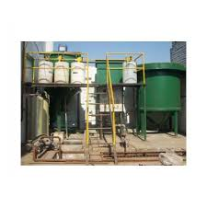
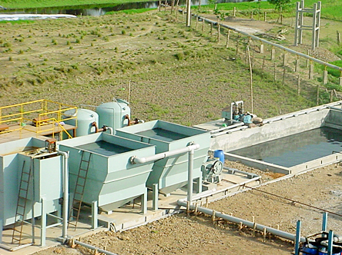
IMAGES OF EFFULENT PLANT
WWRS IMAGE-1
WWRS IMAGE-2

Slide 10
Plant Philosophy
Effluent Treatment Plant:
These effluent treatment plants are used for purifying waste material that is an industrial waste
These treatment plants help in solving environmental pollution issues without exposing same to open environment
These effluent treatment plants are known for saving energy and removing pollution effluent with economical operations and also meet stringent pollution control norms
These effluent treatment plants can treat effluent coming from different areas of plant.

Slide 11
Plant Philosophy
Treatment of Different Effluent Varieties:
These plants can be designed and developed to successfully handle the treatment demands of different working conditions like -
Oil Water Effluent Treatment: These effluent treatment plants are designed to treat mainly water containing oil effluent
The oily water can come from different areas like Turbine building, Workshop, Transformer Area

Slide 12
Plant Philosophy
Service Water Effluent Treatment:
This system allows treatment of effluents that contain turbidity and suspended solids
Here, service water washing effluents from different areas is commonly collected in a collection pit and pumped to flash mixer where chemical mixing takes place to begin the involved treatment process
Coal Handling Plant & Coal Storage Effluent Treatment:
The effluent generated from Coal handling plant and Coal storage area is collected and led through the involved treatment process that leads to decanted water pumped to central monitoring basin

Slide 13
Plant Philosophy
Sludge Handling System:
Here, sludge collected from different clarifiers is pumped through sludge thickener and after completing of the process, supernatant recycled back to main clarifier
Features:
The success achieved by us is attributed to our perfect understanding of the processes involved in waste treatment and in-house capability to conduct studies and thus selecting best combinations of unit operations as provided in the systems to the customers. Some of the standard features of the systems include:
Operates on both aerobic and anaerobic process
Reduces BOD, COD, TSS in industrial effluents
Constructed in RCC as per design definitions

Slide 14
Following are the various application areas of the plant:
Paint shop
Dairy & food industry
Paper mills
Oil refineries
Power Plants
Leather industry
Glass factories
Chemical and processing industries

Slide 15

Thank you

