Slide 1
Training on Dry Fog Dust Suppression System
D.Chakraborty
Instrumentation & Control
Power Plant Division

Slide 2
What is dry fog & why we need it in industry
As its name implies, ‘Dry Fog’ technology is a humidification system which uses water droplets so fine that the immediate environment stays dry, even when levels are elevated to over ninety percent. Wet spots are prevented from forming due to the minute size of individual water droplets produced by these machines. Minimizing droplet size reduces adhesion, so that individual droplets are not attracted to each other to form larger ones. The avoidance of wet spots is crucial in many sensitive industrial applications.

Slide 3
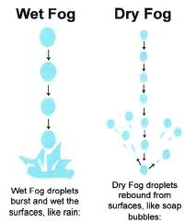
Principle of Operation
It agglomerates the airborne dust particle to water droplets so that the particle become heavy enough to return to the product stream by force of gravity.

Slide 4
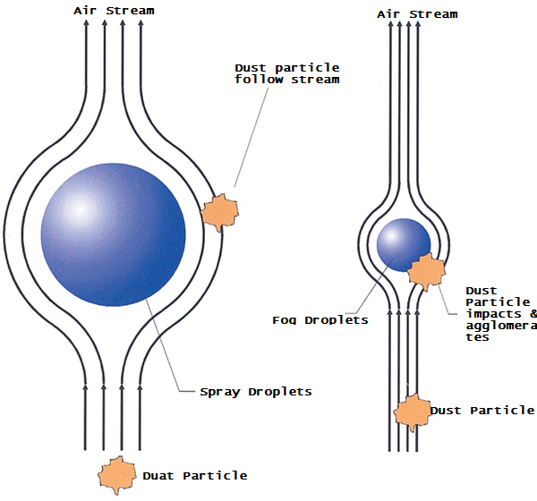
Agglomeration
1. Enough water droplets of the same size as the dust particles have to be generated at the same rate as the dust particles.
2. Both dust particles and water droplets have to be contained in the same area so that agglomeration can occur.

Slide 5
Theory of operation
Advance technology uses a special air-atomizing nozzle that produces a very dry fog to agglomerate and remove airborne dust particles from various material handling and processing operations. The advance technology system utilizes compressed air and plain water to produce these 1-10 micron droplets (true fog). These ultra-fine water droplets attach (agglomerate) to like size airborne dust particles, sometimes referred to as PM-10 (particulate matter 10 microns or smaller). The slightly wetted dust particles are then heavy enough to be removed from the air by their added weight and fall back into the process. It is important to note, we only wet the dust, not the material, resulting in very low water and power consumption, with no expensive chemicals or significant wetting of the product (always less than 1/2 % by weight, typically no more than 0.1% moisture addition).

Slide 6
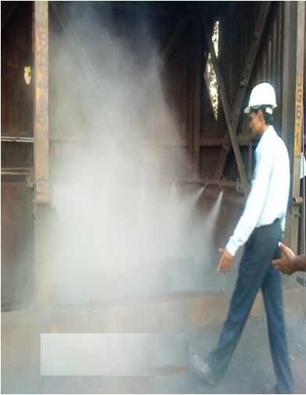
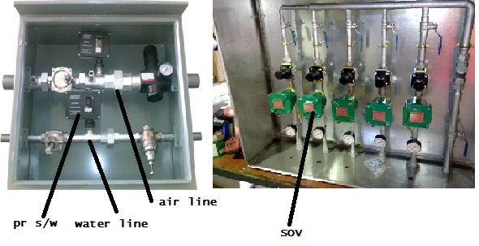
Dry Fog Images

Slide 7
Operation of foggers
The design of the system is based on a unique nozzle that can produce a very dense fog of 1 - 10 micron in size of water droplets that can literally blanket dust source and keep the dust particles from becoming air borne. The dual flow nozzle is an air driven device for fogging liquids by passing them through a field of high frequency sound waves. This is accomplished by compressing air stream of a specially designed converge section of the nozzle. The result is an air stream that will accelerate past the speed of sound, in the converge section.
When it passes the speed of sound, a primary shock wave is generated at the mouth of the nozzle. To enhance the fogging capacity, a resonating chamber in the path of the air stream reflects the air stream back it self to amplify the primary shock wave. Once the shock wave is generated, water is delivered through annular orifices where it is sheared in relatively small droplets. These small droplets are then carried by the primary air stream in to the shock wave and exploded into thousands of micron size fog droplets. The air then escapes around the resonator chamber and carries the droplets downstream in a soft low velocity fog pattern.

Slide 8
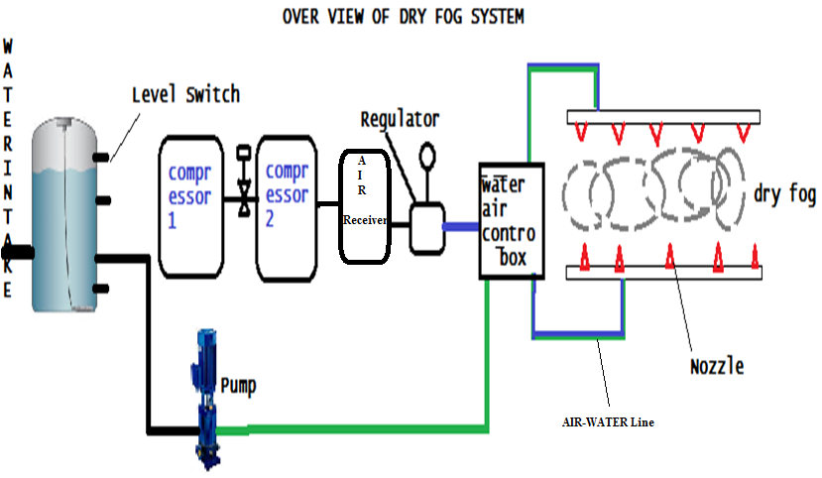
Over View of Dry Fog System

Slide 9
Advantages
Dust Generation is suppressed.
2. Reduced cost
3. Moisture addition 0.1% only
4.Compatible to PLC
5 Easy to install

Slide 10
THANKYOU FOR YOUR VALUABLE TIME

